Slide 1
SMART SAGE
RAG AI – Study Helper ChatBot
SUPERVISED BY:
DR. N. SARAVANAN PROFESSOR/CSE HOD
PRESENTED BY:
S. RAGULAN - 311621104035
T. BORIS WILBERT - 311621104008
M. VISHAAL - 311621104056

Slide 2
ABSTRACT
The AI Study Helper is designed to assist students in retrieving accurate and relevant educational content.
It integrates ChromaDB, Wikipedia API, and web scraping for knowledge extraction.
The system enhances learning through an optimized Retrieval-Augmented Generation (RAG) model.
FastAPI serves as the backend, ensuring fast and scalable processing.
The chatbot is structured to filter non-educational content, improving the study experience.

Slide 3
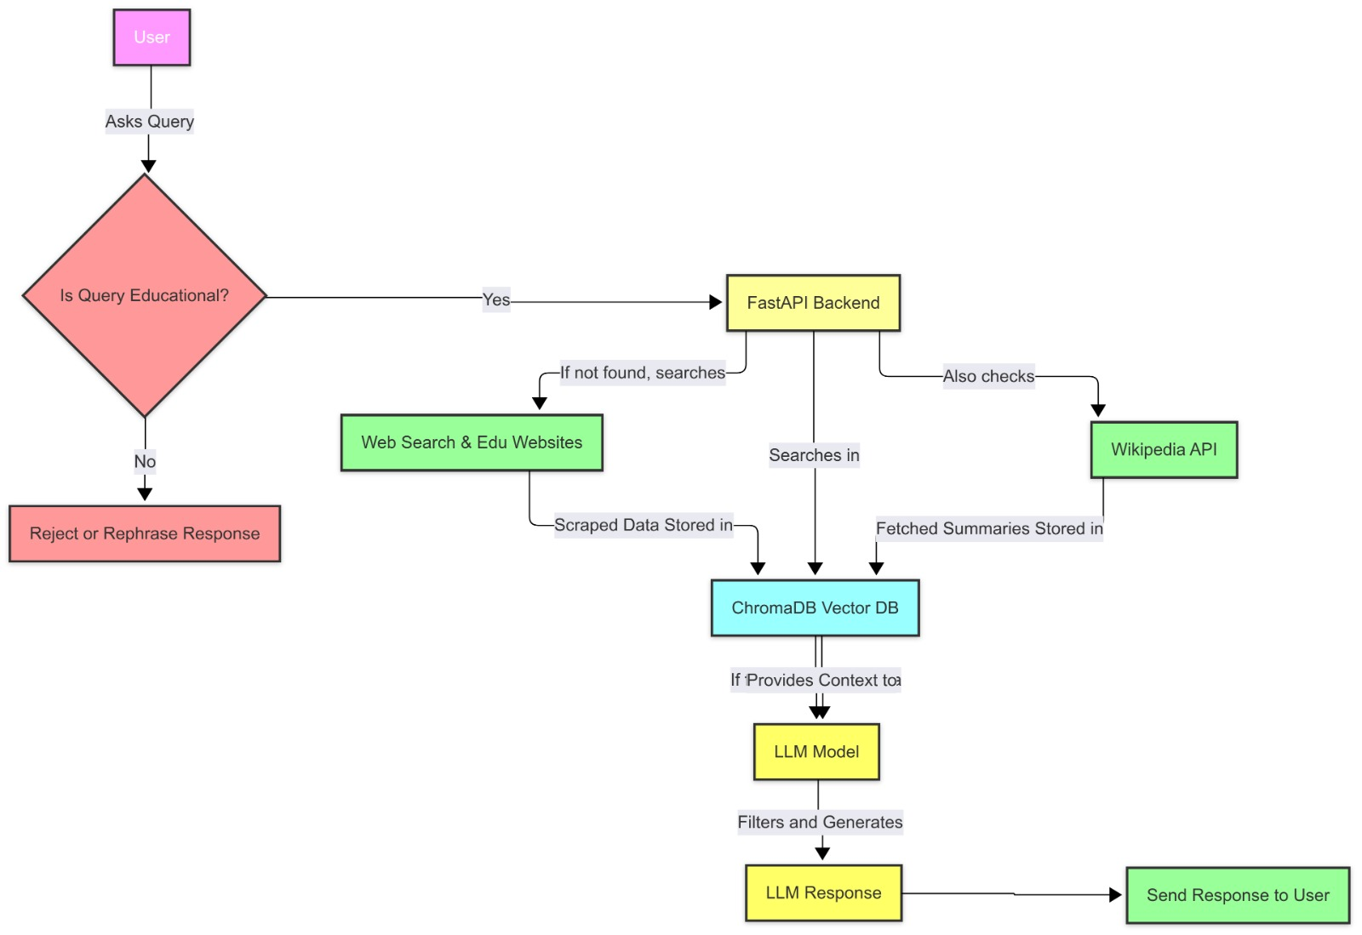
ARCHITECTURAL DESIGN

Slide 4
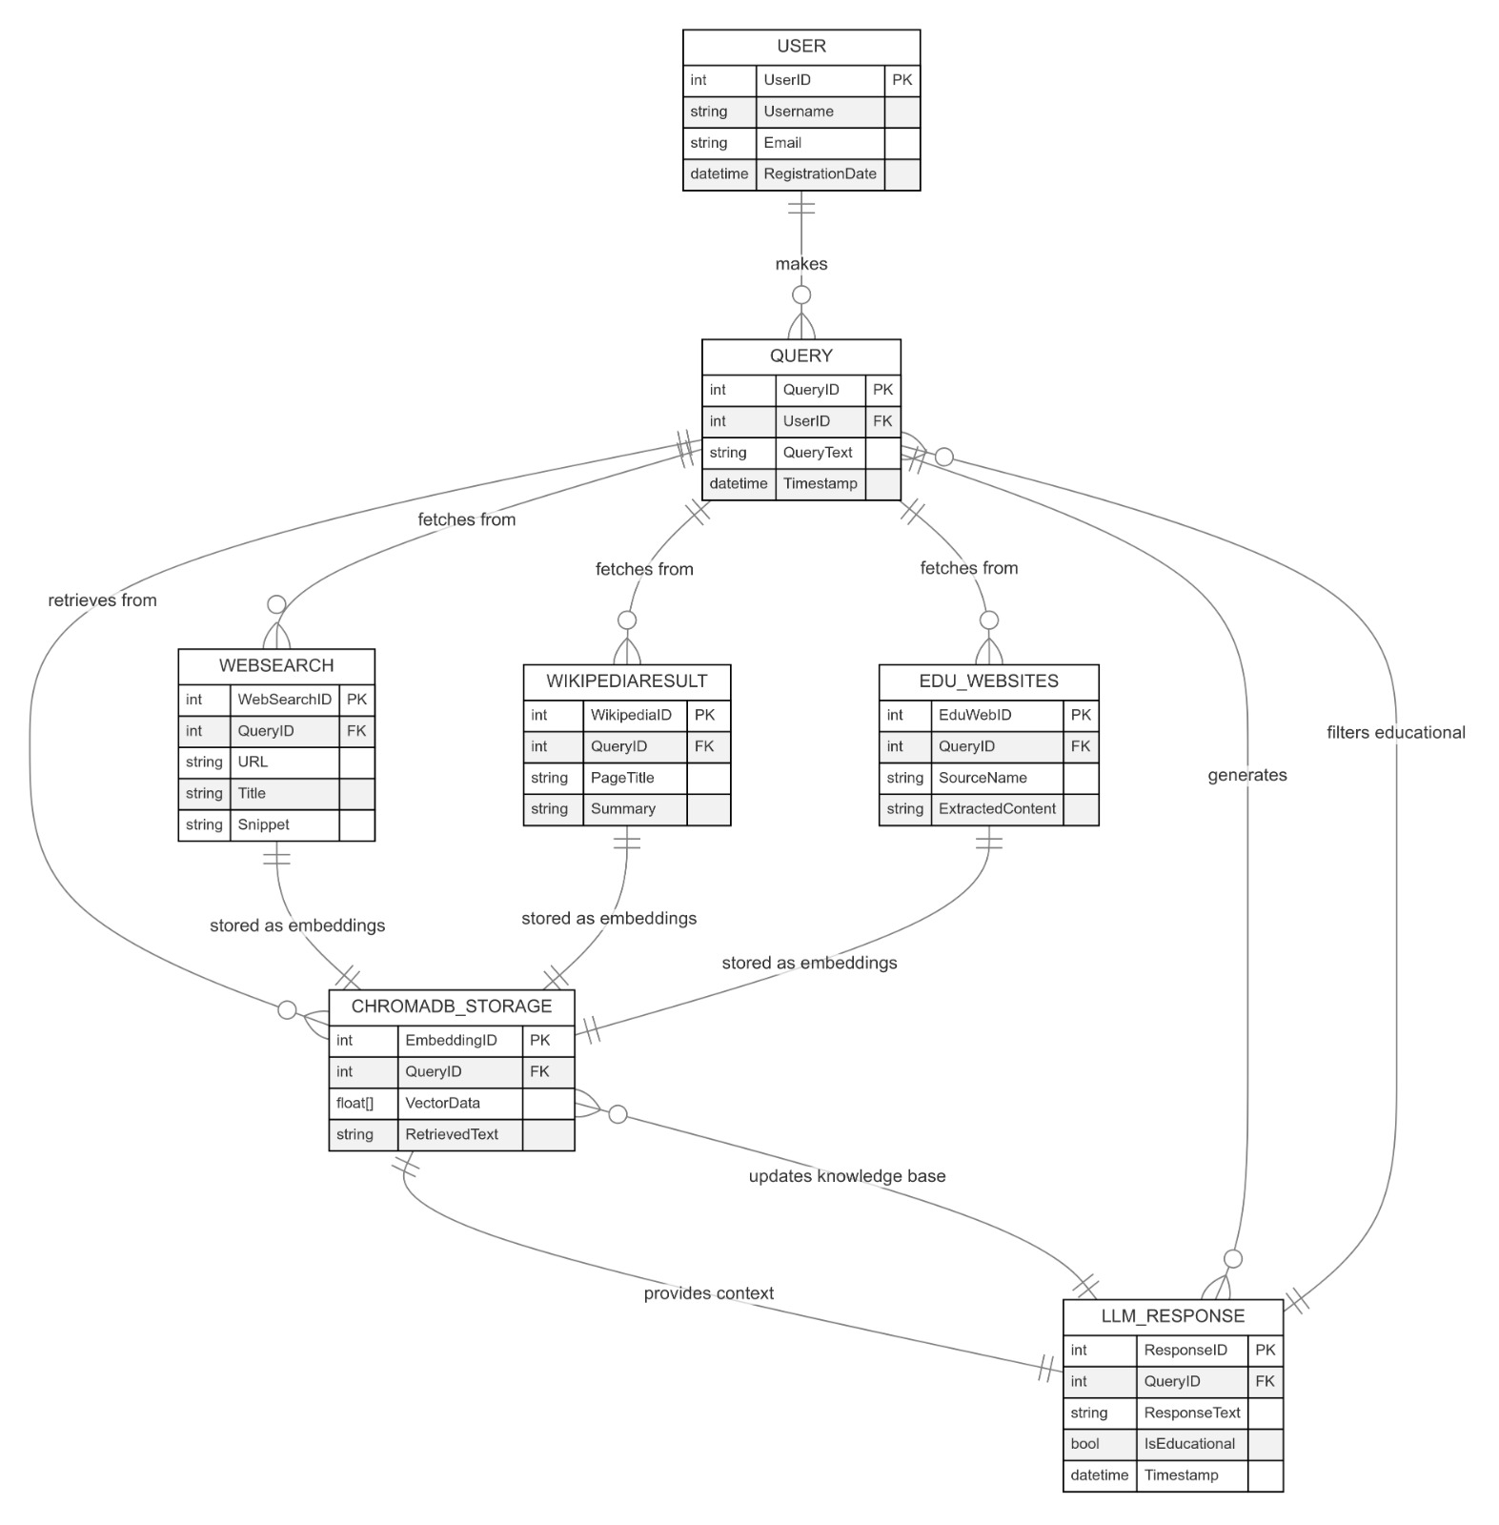
ER DIAGRAM

Slide 5
TECHNIQUES USED
Query Classification: Uses Sentence Transformers to check if a query is educational (O(N)).
Semantic Search: Retrieves relevant data using ChromaDB (ANN Search, O(log N)).
Web Scraping: Extracts educational content via BeautifulSoup/Scrapy (O(N)).
Wikipedia API: Fetches relevant summaries efficiently (O(1)).
LLM-based Response: Generates study-related answers using Transformer models (O(N²)).
Response Filtering: Ensures only educational content is provided (O(N)).
Data Storage & Retrieval: Stores embeddings in ChromaDB for fast access (O(log N)).

Slide 6
EXPECTED OUTCOMES
- Faster Response Retrieval: Optimized ChromaDB ensures instant access to relevant study materials.
- High Accuracy: Combines semantic search, Wikipedia API, and web scraping for precise educational content.
- Scalable System: Handles large datasets efficiently using ChromaDB vector storage and indexing.
- Improved Study Experience: Delivers reliable, study-focused responses without irrelevant distractions.
- Web-Based Interface: Interactive chatbot with FastAPI backend, ensuring seamless user experience.

Slide 7
CODE IMPLEMENTATION
Query Processing & Classification
Checks if the user query is educational using Sentence Transformers.
Retrieval from ChromaDB
Searches stored vector embeddings for relevant study materials.
Fallback Mechanisms
If ChromaDB has no results, quaeries Wikipedia API, Web Scraping, and LLM-based response.
Response Generation
LLM generates a response only if the content is educational.
Efficient Data Storage
Stores processed embeddings in ChromaDB for faster future retrieval.
FastAPI Backend & Chatbot UI
Implements FastAPI for API handling and a web-based chatbot for user interaction.

Slide 8
REFERENCES
1. Neumann, A. T., Yin, Y., Sowe, S., Decker, S., & Jarke, M. (2025). An LLM-Driven Chatbot in Higher Education for Databases and Information Systems. IEEE Transactions on Education, 68(1), 103-113. DOI: 10.1109/TE.2024.3467912.
2. Ondáš, S., Pleva, M., & Hládek, D. (2019). How Chatbots Can Be Involved in the Education Process. IEEE, 575-578. DOI: 10.1109/ondas2019.
3. Kim, Na-Young, Cha, Yoonjung, & Kim, Hea-Suk. (2019). Future English learning: Chatbots and artificial intelligence. Multimedia-Assisted Language Learning, 22(3), pp. 32-53.
4. Akcora, D.E., et al. (2018). Conversational Support for Education. In: Penstein Rosé, C. et al. (eds) Artificial Intelligence in Education. Lecture Notes in Computer Science, vol 10948. Springer, Cham, pp. 14-19.
5. Smutny, P., & Schreiberova, P. (2020). Chatbots for learning: A review of educational chatbots for the Facebook Messenger. Computers & Education, 151, pp. 1-11.

Slide 9
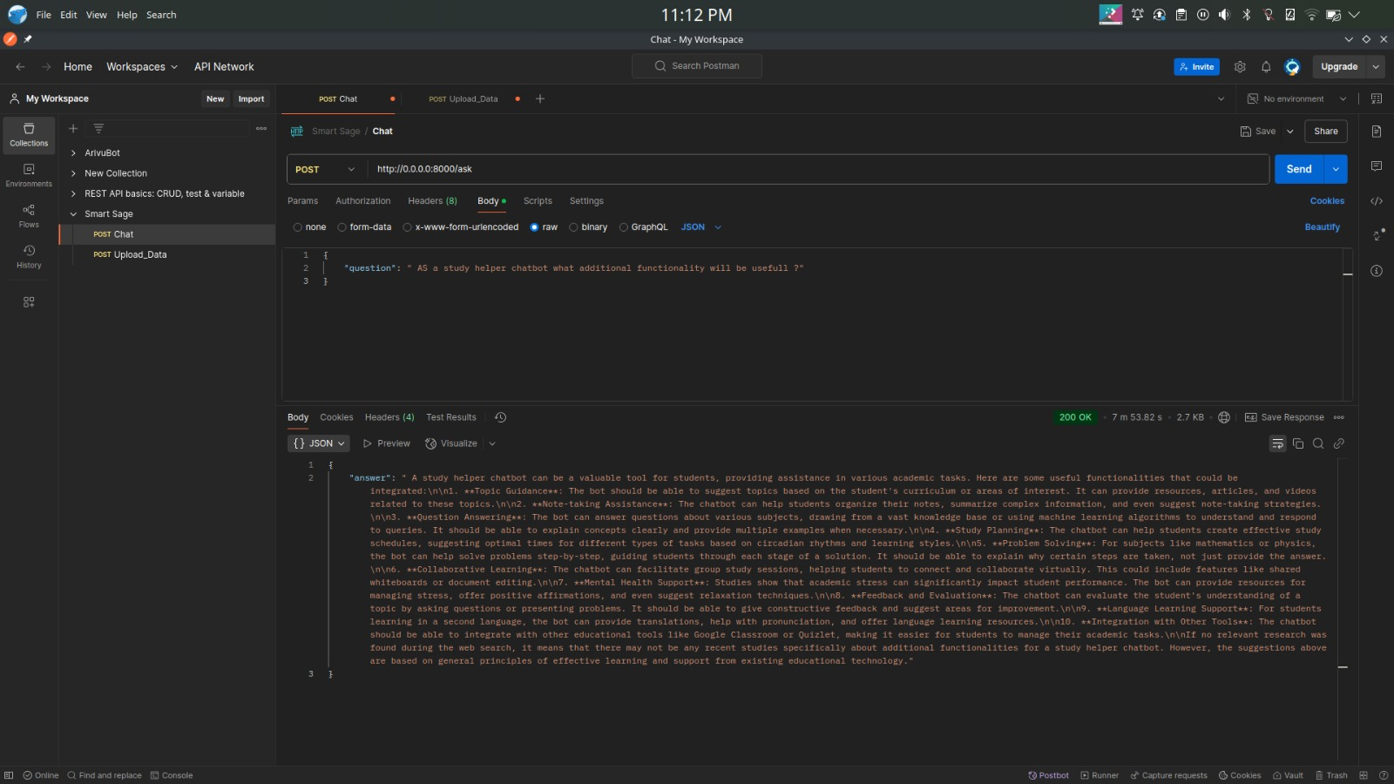
EDUCATIONAL

Slide 10
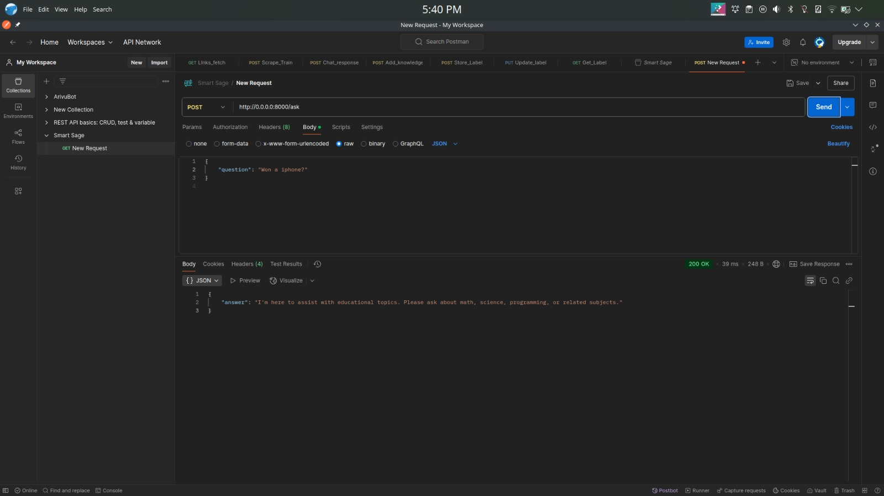
NON - EDUCATIONAL

Slide 11
Thank You

